Slide 1
Introduction on “Linear regression and linear mixed-effects model in R”
Fan Ze-Xin
XTBG
2019.03.08

Slide 2
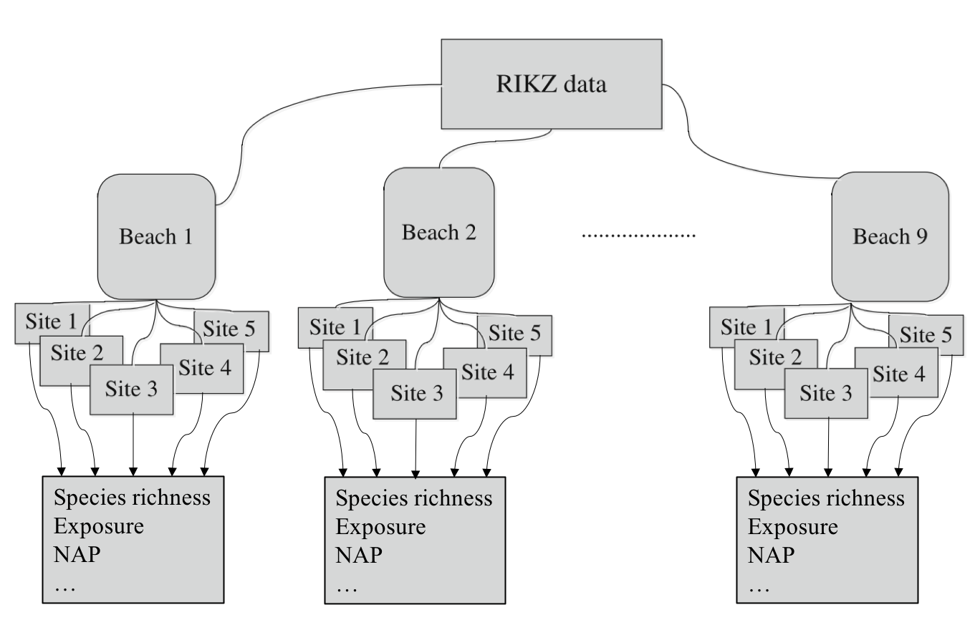
The RIKZ data
9 beachs; each beach 5 sites.
Species Richness: number of species
NAP: height of the sampling station
Exposure: wave action, length of the surf zone, grain size, depth of the anaerobic(厌氧） layer

Slide 3
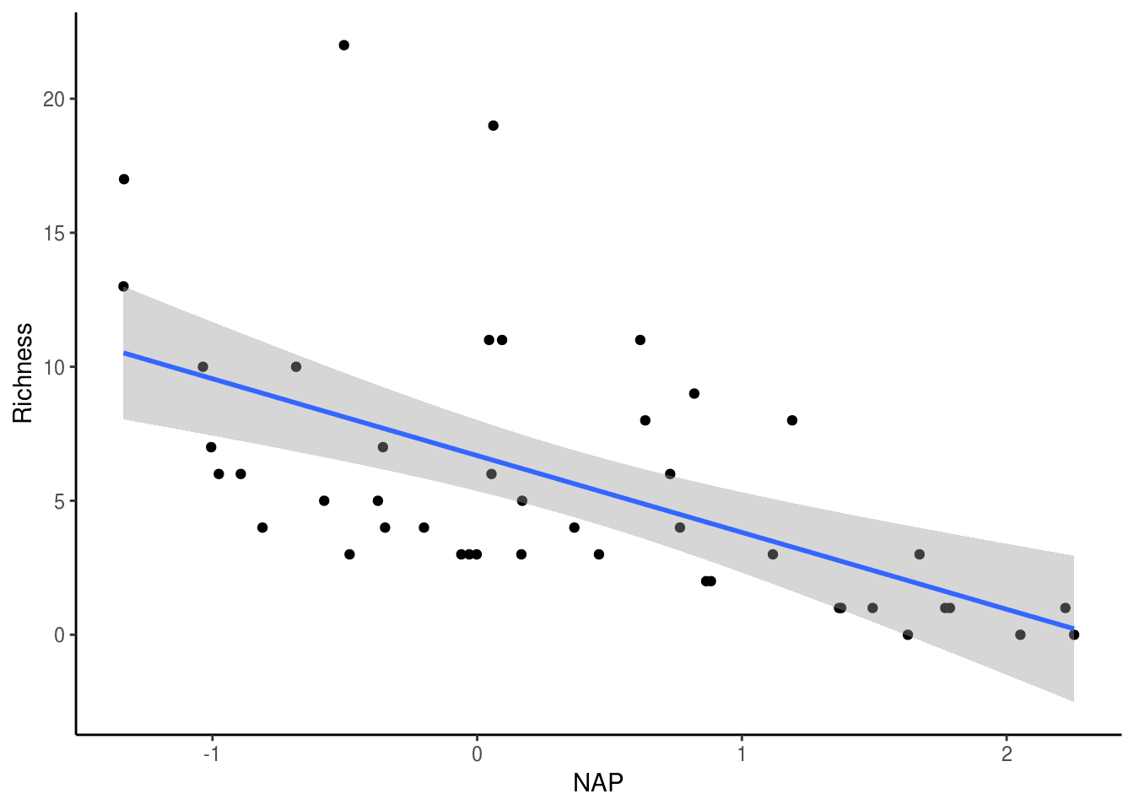
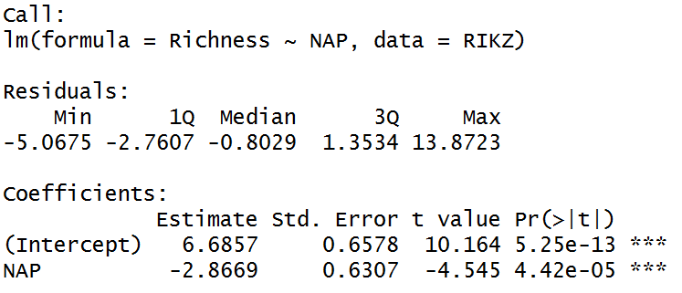
Linear regression model
Lm1 <- lm(Richness ~ NAP, data=RIKZ)
summary(Lm1)

Slide 4
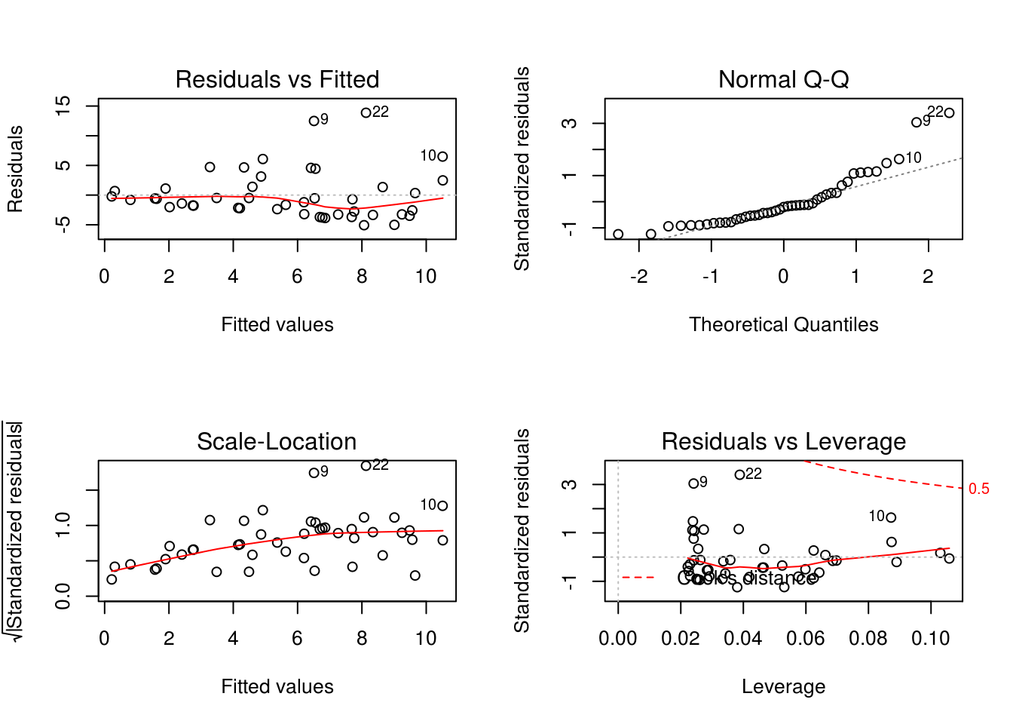
non-normality
Homogeneity assumption is violated:
increasing variance in the residuals with increasing fitted values

Slide 5
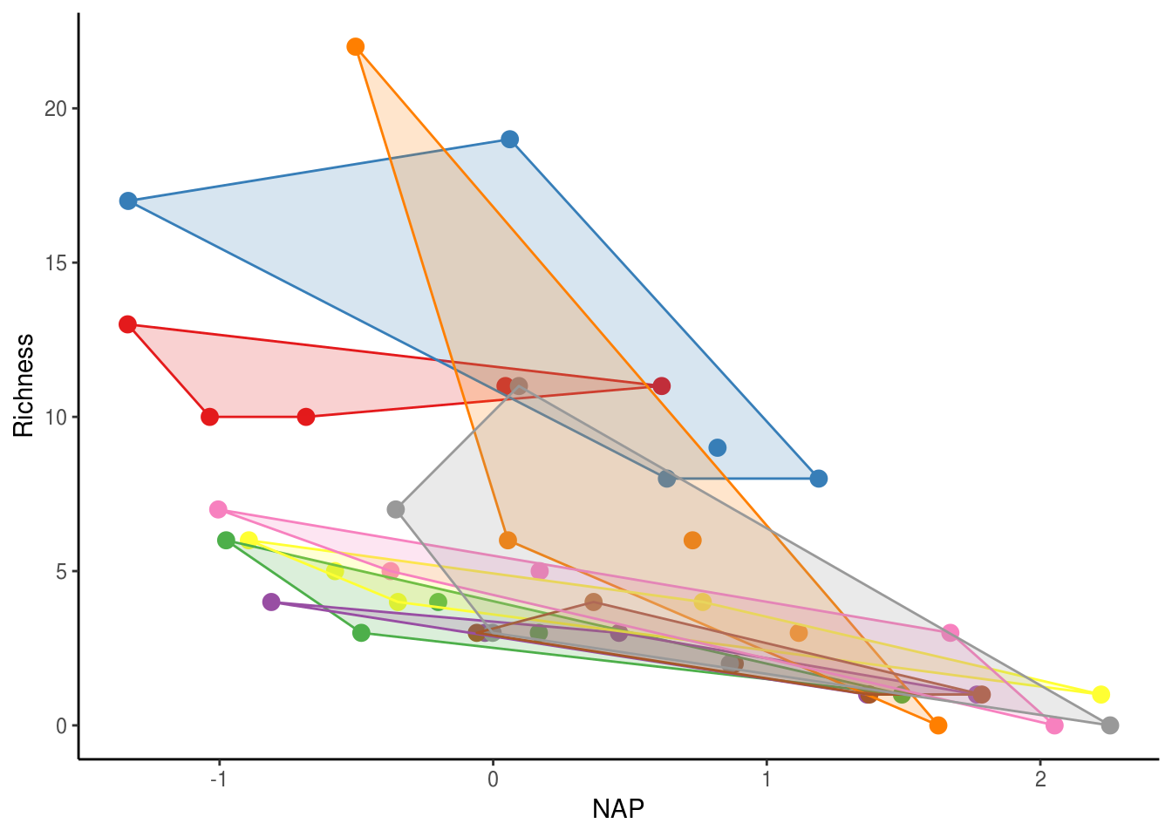
Non-independence of observations
observations among sites within a beach are not independent
observations from the same beach tend to cluster together

Slide 6
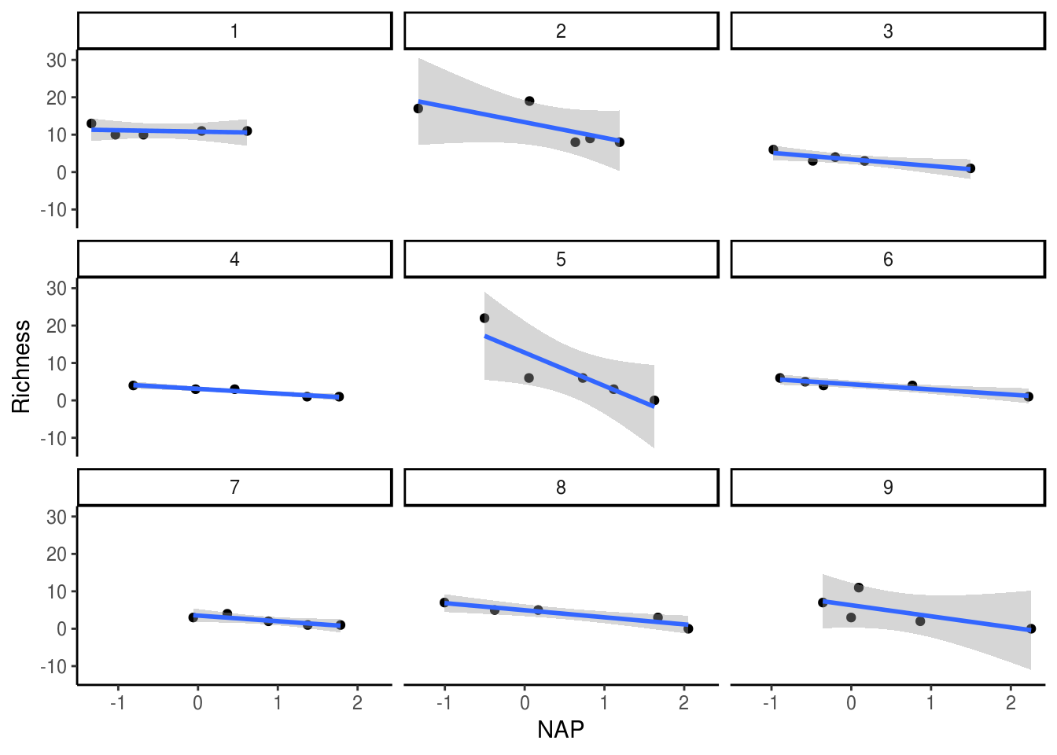
Accounting for non-independence

Slide 7
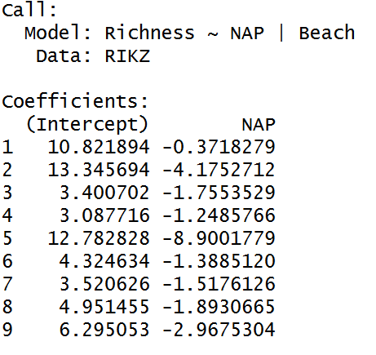
Beta<-vector(length=9)
for (i in 1:9){
tmpout<-summary(lm(Richness~NAP,subset = (Beach==i),data=RIKZ))
Beta[i]<-tmpout$coefficients[2,1]
}
library(nlme)
lmList(Richness ~ NAP|Beach, data=RIKZ)

Slide 8
Random intercept model
We do not want to pay the steep price of 8 degrees of freedom
But still want to estimate the variance among beaches and must account for the non-independence of sites within beaches.
Include Beach as a random effect, while NAP remains a fixed effect
we model a separate y-intercept (i.e. Richness at NAP = 0) for each beach and estimate the variance around this intercept
library(nlme)
RIKZ$fBeach <- factor(RIKZ$Beach)
Mlme1 <- lme(Richness ~ NAP, random = ~1 | fBeach,data=RIKZ)
summary(Mlme1)
(1|Beach) is the random effect term
1 denotes this is a random-intercept model

Slide 9
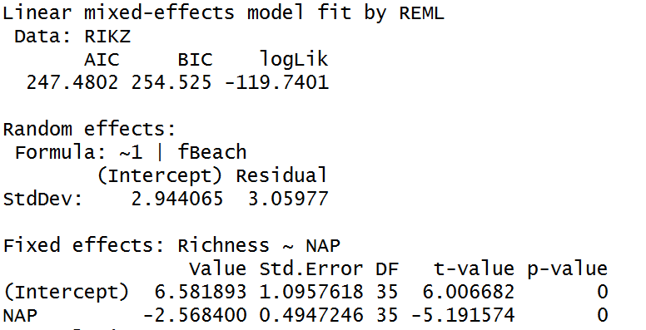
AIC will be especially useful for our lecture on Model Selection
Variance associate with the effect of beach: 2.94406^2 = 8.6674
Differences between beaches account for : (8.6674/ (8.6674+ 9.361764) * 100 = 48%

Slide 10
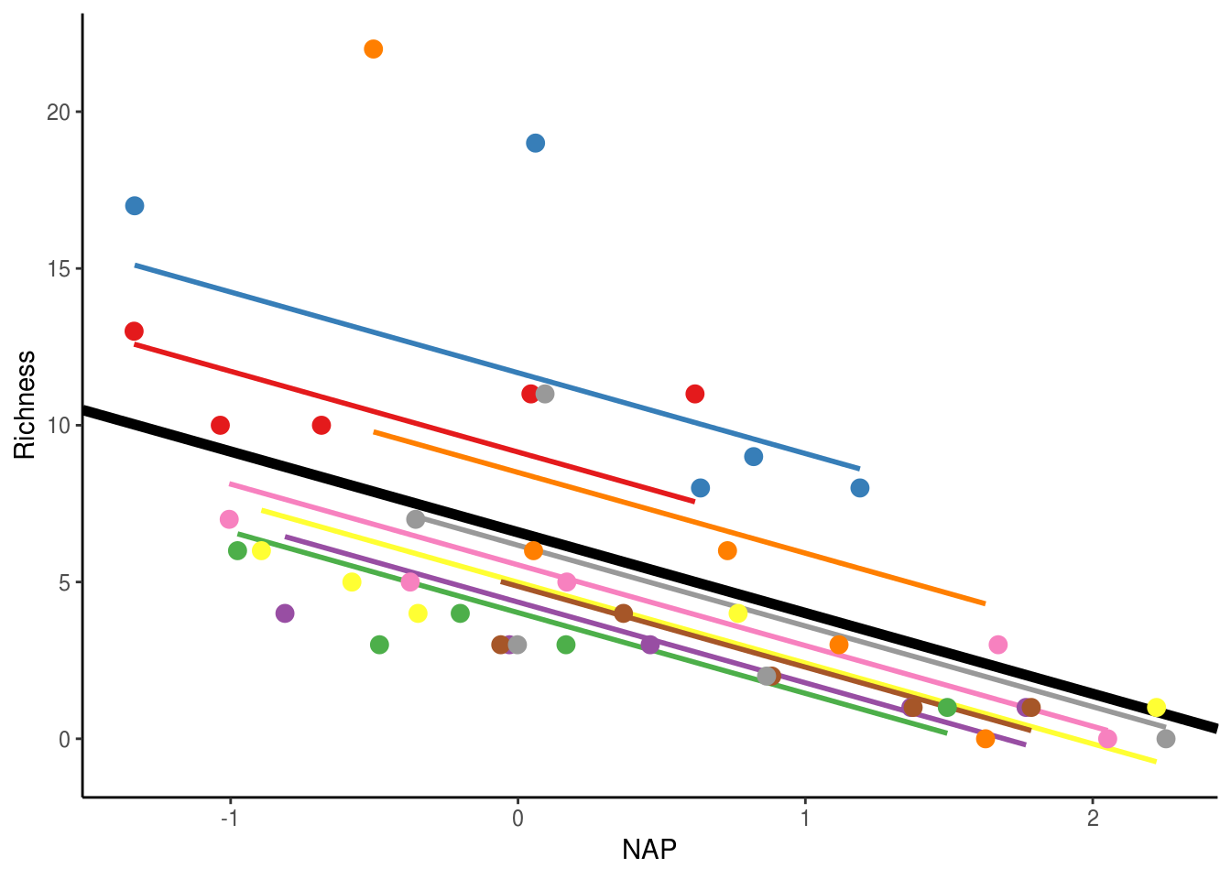
thick black line corresponds to the fitted values associated with the fixed-effect component of the model (i.e. 6.58 x -2.56(x))

Slide 11
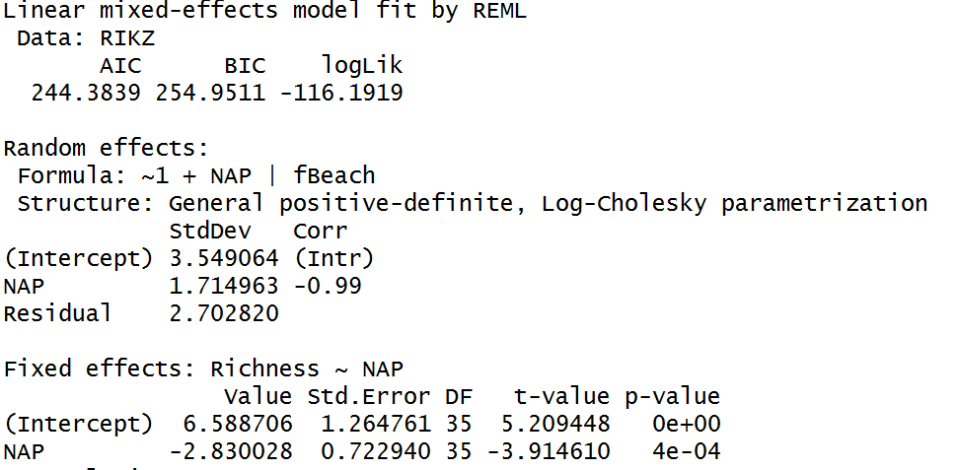
Random intercept-slope model
Allows both the intercept and slope of the relationship between Richness and NAP to vary across beaches
Mlme2 <- lme(Richness ~ NAP,
random = ~1 + NAP | fBeach, data = RIKZ)
summary(Mlme2)
Cor term, which estimates the correlation between the intercept and slope variances
Cor ~ -1: beaches with larger intercepts also have more steeply negative slopes

Slide 12
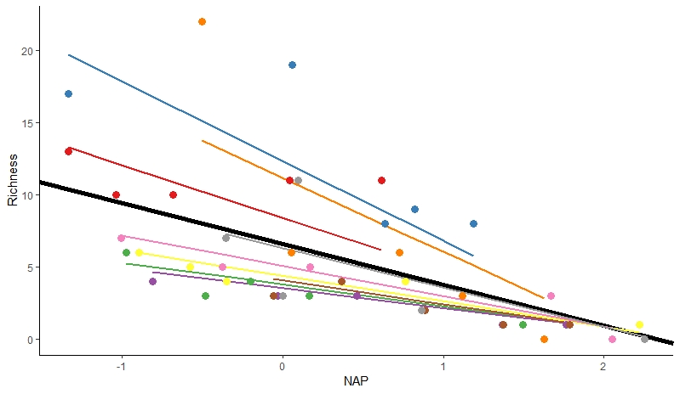

Slide 13
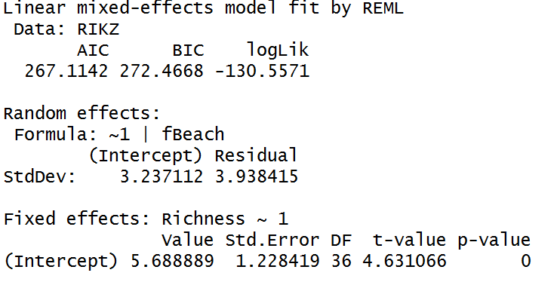
Random effects only model
Mlme3 <- lme(Richness ~ 1, random = ~1 | fBeach, data = RIKZ)
summary(Mlme3)

Slide 14
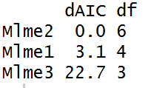
Model selection
library(bbmle)
AICtab(Mlme1, Mlme2, Mlme3)
B1 <- gls(Richness ~ 1 + NAP * fExp,
method = "REML", data = RIKZ)
B2 <- lme(Richness ~1 + NAP * fExp, random = ~1 | fBeach,
method = "REML", data = RIKZ)
B3 <- lme(Richness ~ 1 + NAP * fExp, random = ~1 + NAP | fBeach,
method = "REML", data = RIKZ)
AIC(B1, B2, B3)
summary(B2)
The lower dAIC, the better
Normally, no much difference when dAIC within 2.5
#Drop interaction
B2 <- lme(Richness ~1 + NAP + fExp,
random = ~1 | fBeach, method = "REML", data = RIKZ)
summary(B2)

Slide 15
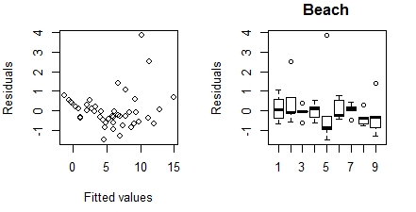
##Model validation
E2 <- resid(B2, type="normalized")
F2 <- fitted(B2)
op<-par(mfrow=c(2,2),mar=c(4,4,3,2))
MyYlab="Residuals"
plot(x=F2,y=E2,xlab="Fitted values",ylab=MyYlab)
boxplot(E2~fBeach,data=RIKZ,main="Beach",ylab=MyYlab)
par(op)

